Slide 1
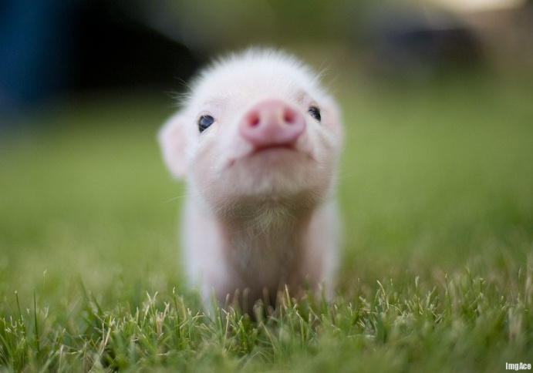
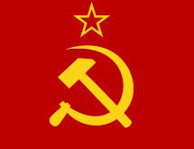
Animal Farm and The Russian Revolution
Zach Taylor and Joe Ertle

Slide 2
Squealer a brief overview
Persuasive
Two Faced
Hypocritical (like most other pigs in the story)

Slide 3
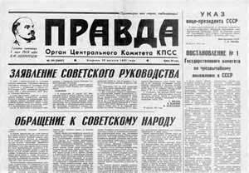
Russian Media/Pravda
Were controlled partially by Stalin himself
They could only write or report of the beneficial actions that he preformed
Made even the most atrocious laws sound as though they were helping the people in some way

Slide 4
Parallels between Squealer and the Russian Media
Russian Media/Pravda | Squealer
- Supported the people and Stalin during his reign so they could protect themselves from govermental harm | - “Persuaded” the less competent animals into believing that he wanted the best for them even though he was really trying to keep himself in power
-Could only write about how Stalin was an uncorrupt leader -Stalin Was an Editor of the Pravda | -During Napoleon's reign over the Farm Squealer twisted the commandments similar to how the Pravda changed the facts of Stalin’s leadership -Napoleon was also the “editor” of the commandments as he told Squealer what to add to the commandments

Slide 5
Thank you for observing this high quality presentation

